Slide 1
Notes:
1

Slide 2
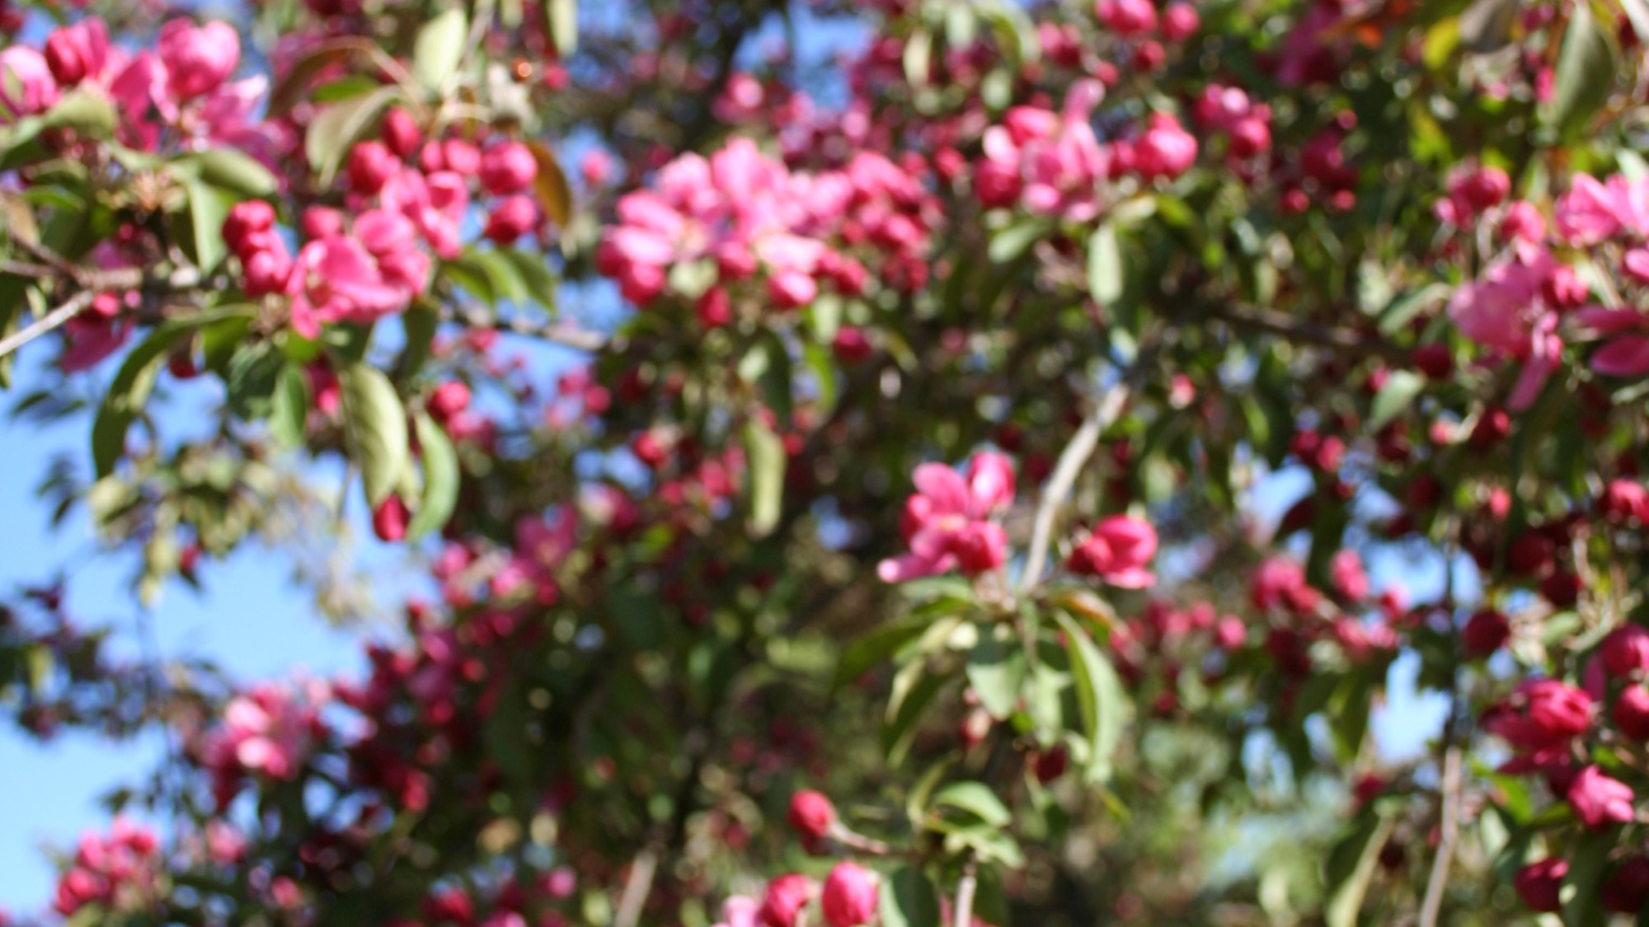
Assignment 1
Assignment 2
Please fill in the feedback form:
bit.ly/topinpuisto
Please do this assignment in groups.
Based on your notes choose one of the products or solution that you found yesterday.
Research what is the process behind it? How the waste is processed to a new product?
How you would present the process in Kahmari?
Make a visual presentation. Please send it to
sonja.lankiniemi@turkuamk.fi
At 2 pm we will go through your answers.
2

